Slide 1
Funnel introduction
seq
B4-4-4
Funnel
L12H768
Bert

Slide 2
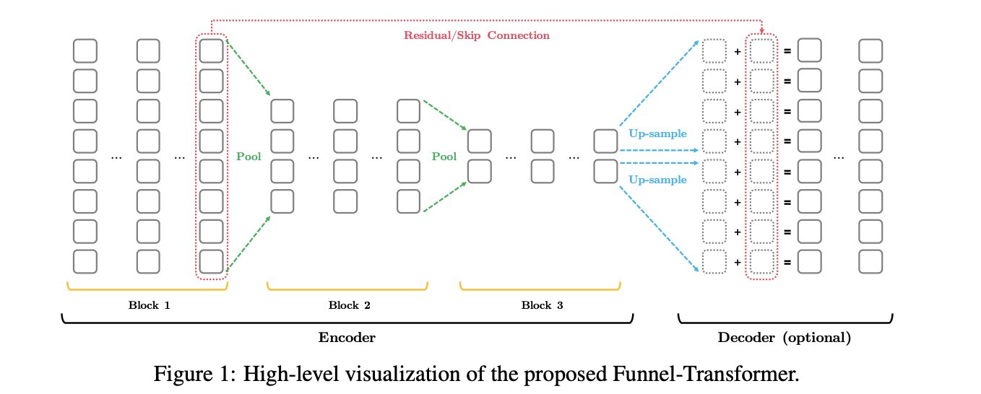
Funnel introduction
For task only require [cls] token, only encoder is needed.
For task use the entire sequence, decoder is added.

Slide 3
Funnel introduction : pool q only
Original_k
Original_q
cls
[cls]
pooled_q
[cls]
[cls]
In the first layer after pooling,the attention is computed using pooled q and original k,v.

Slide 4
Funnel introduction
For task only require [cls] token, only encoder is needed.
For task use the entire sequence, decoder is added.

Slide 5
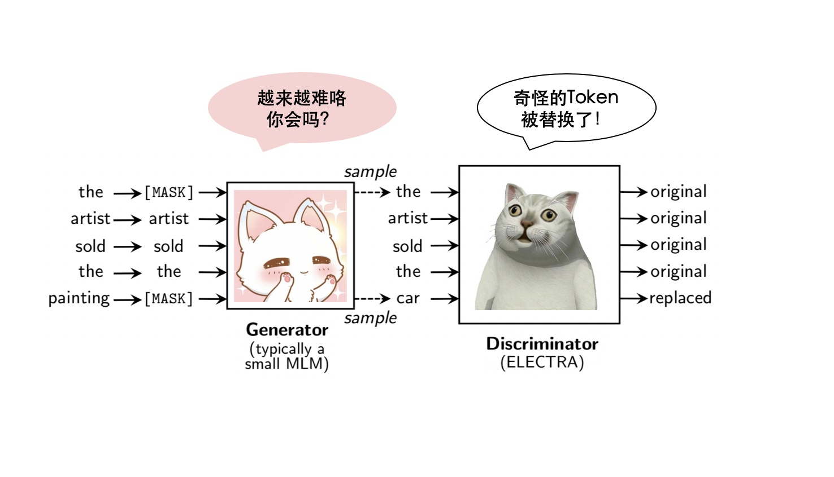
Funnel introduction
Special token like [cls] and [sep] is not pooled.
Max pooling perform best in [Max , Mean , Top-Attn].
6-6-6 is better than 5-5-5-5/8-8.
It tested both MLM & ELECTRA for pretraining
Use Relative attention parameterization proposed in Transformer-XL to adapt pooling.

